Slide 1
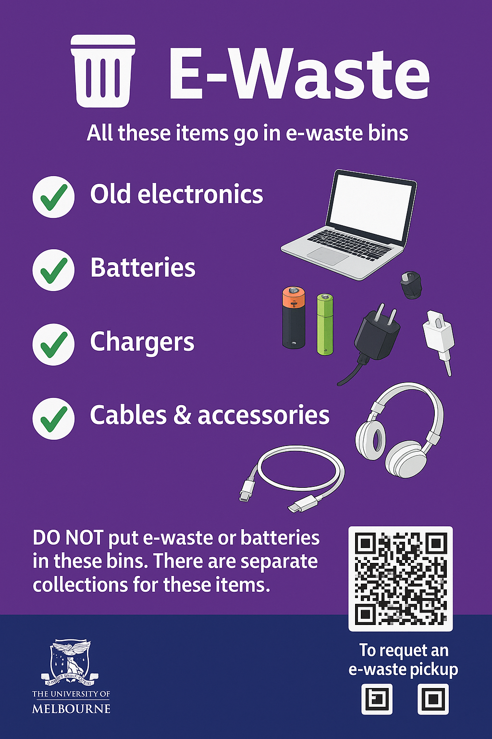


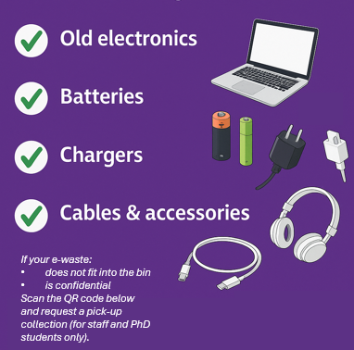

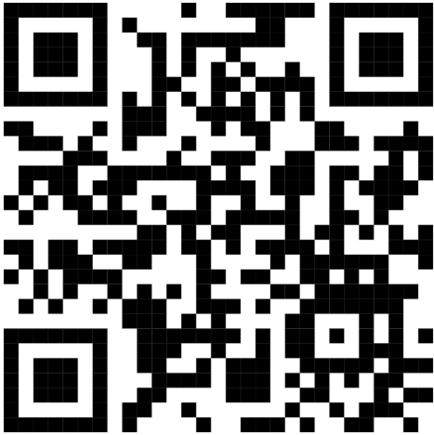
E-Waste
DO NOT put any landfill, recycle or food organics in these bins
For further information please visit: sustainablecampus.edu.au

